Slide 1
MphA ROCker model summary

Slide 2
Model 1
MphA and MphF cluster positive
All other clades negative

Slide 3
My default distance clustering algorithm has made a funny cluster on the tree topology.
I can see how it would make sense based one branch length distances.
mph(E)
mph(G)
mph(A)
Model 1: MphA & MphF
mph(F)
Positive
Negative
mph(B)
mph(C)

Slide 4
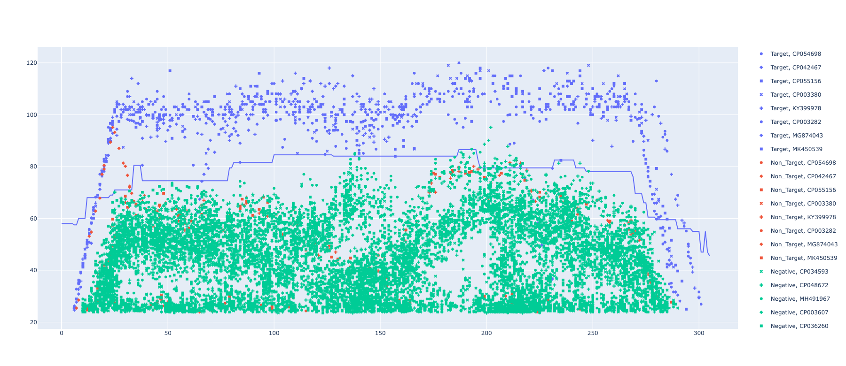
MphA and MphF ROCker model using ROCkOut – 150bp reads

Slide 5
Model 2
MphA stand-a-lone Clade positive
All other clades negative

Slide 6
Include some accessions from
90% sequence similarity clustering.
Each tip label on this tree represents a cluster of sequences from the search results.
Can we get a good model for mph(A) on its own?
mph(E)
mph(G)
mph(A)
Model 2: MphA Stand-a-lone
mph(F)
Positive
Negative
mph(B)
mph(C)

Slide 7
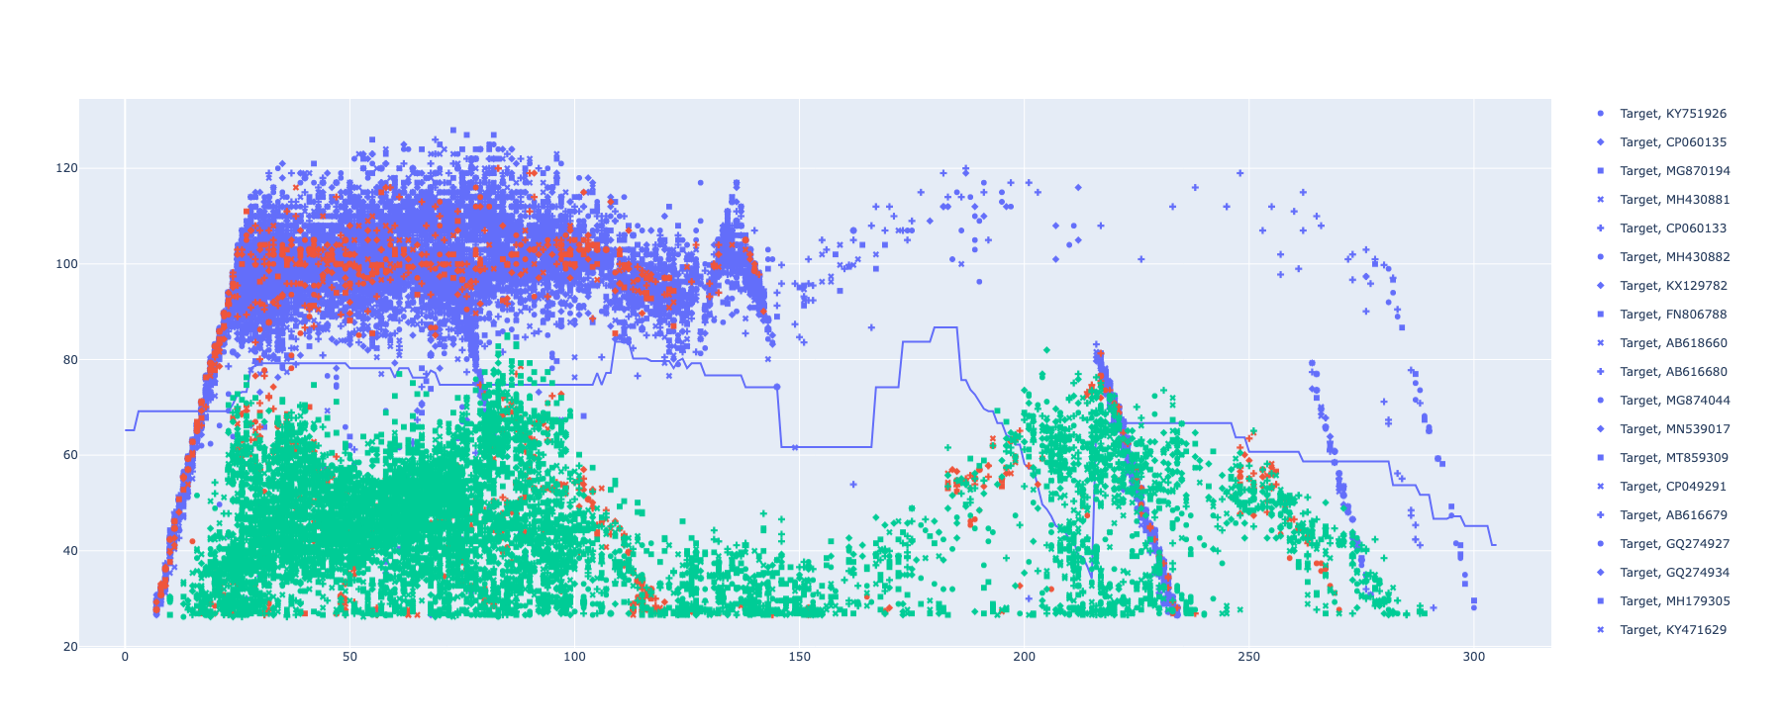
MphA stand-a-lone ROCker model using ROCkOut – 150bp reads

Slide 8
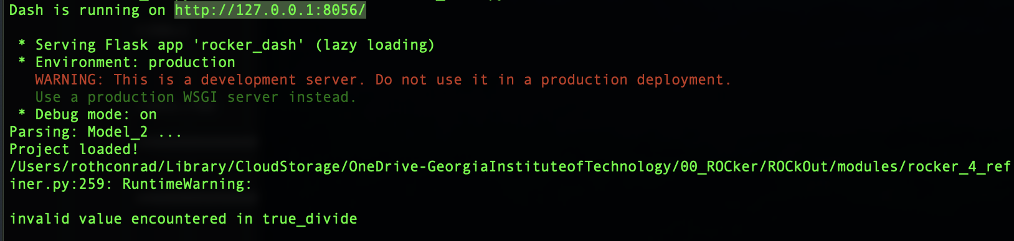

Slide 9
Model 3
MphB Clade positive
All other clades negative

Slide 10
My default distance clustering algorithm has made a funny cluster on the tree topology.
I can see how it would make sense based one branch length distances.
mph(E)
mph(G)
mph(A)
Model 1: MphB
mph(F)
Positive
Negative
mph(B)
mph(C)

Slide 11
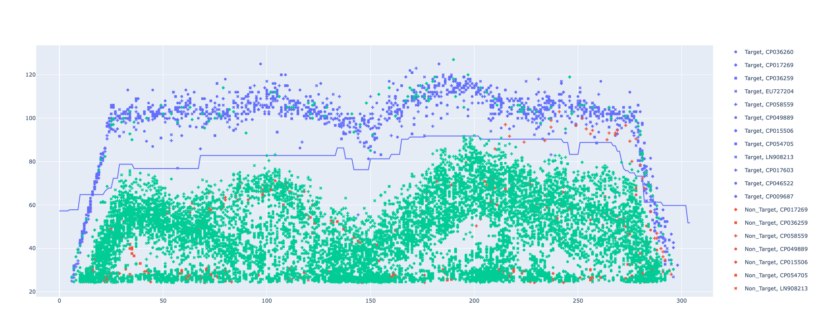
MphB ROCker model using ROCkOut – 150bp reads

Slide 12
Model 4
MphC Clades positive
All other clades negative

Slide 13
My default distance clustering algorithm has made a funny cluster on the tree topology.
I can see how it would make sense based one branch length distances.
mph(E)
mph(G)
mph(A)
Model 1: MphC
mph(F)
Positive
Negative
mph(B)
mph(C)

Slide 14
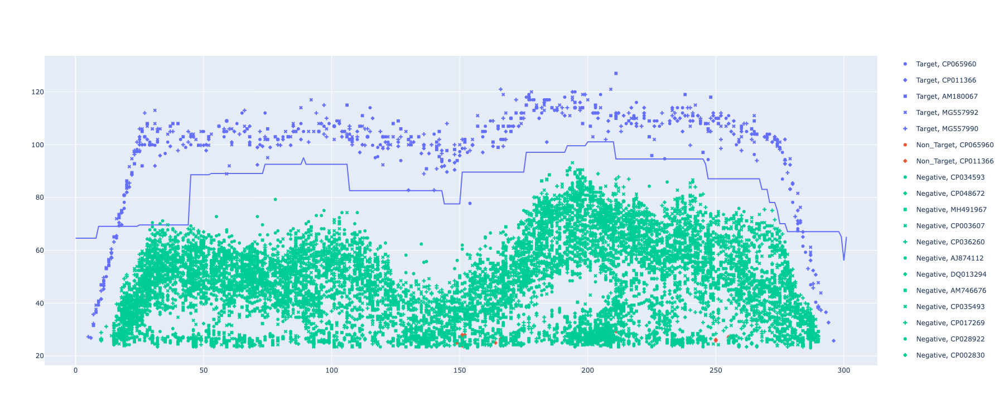
MphC ROCker model using ROCkOut – 150bp reads

Slide 15
Model 5
MphE and MphG Clades positive
All other clades negative

Slide 16
My default distance clustering algorithm has made a funny cluster on the tree topology.
I can see how it would make sense based one branch length distances.
mph(E)
mph(G)
mph(A)
Model 1: MphE and MphG
mph(F)
Positive
Negative
mph(B)
mph(C)

Slide 17
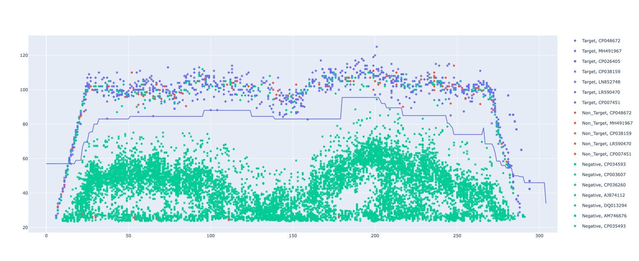
MphE & MphG ROCker model using ROCkOut – 150bp reads

